Slide 1
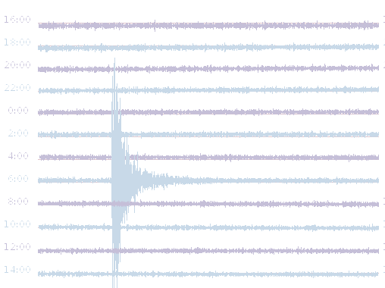
AZORES SEISMIC NETWORK
Matilde Silva , Maria Escuer & Idalina Veludo, Lisbon, Oct. 25 – 27 2017
Plot 24h PM_ROSA, 29 – 30 April 2013

Slide 2
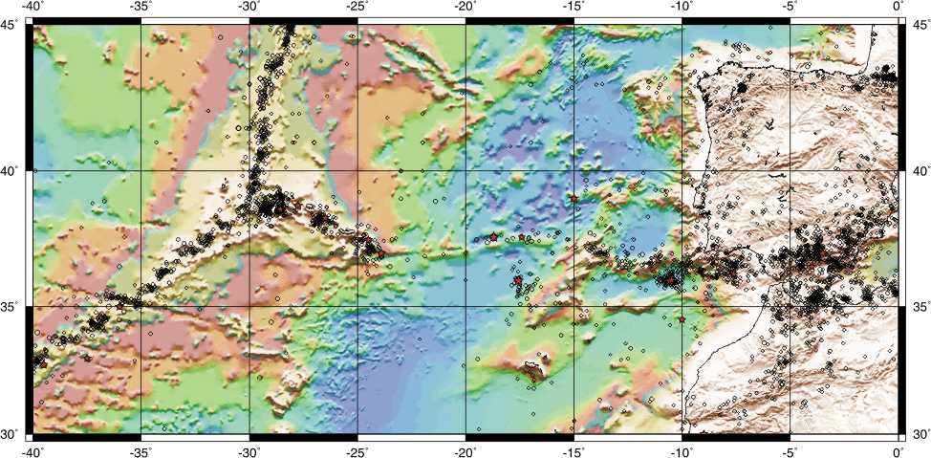
AZORES SEISMIC NETWORK
Seismo-Tectonic Environment
EA Plate
NA Plate
ATJ
FG
N Plate
Sismicidade 1900-2000 (ISC)

Slide 3
AZORES SEISMIC NETWORK
Objective:
Real time seismic monitoring Local, Regional and Distant seismic activity through precise and permanent data and instrumental measures;
Collect and archive of quality seismic data for scientific research;
Rapid analysis and determination of main seismic parameters
Alert the Civil Authorities, Institutions and Community.
(Continuously record and archive ground motion data that comes simultaneously and in real-time, or near-real, from a network of acquisition systems equipped with seismic stations, sensors (either velocity or acceleration), power supply systems, data communication systems and GPS's. The data or records of the acquisition systems are transmitted and concentrated in SOC’s in the form of numerical data. From these records produce a catalog of seismic events that is distributed to the civil and scientific community.)

Slide 4
AZORES SEISMIC NETWORK
Azores, 1983/01 – 2017/03

Slide 5
AZORES SEISMIC NETWORK
IPMA
Azores Network:
Short Period, Broad Band and Strong Motion Sensors:
IPMA Network
IRIS / IDA Network
CTBTO & Internacional Monitoring System (IMS)
Hidroacoustic, Infrasounds
IPMA-IST Protocol – Strong Motion Network

Slide 6
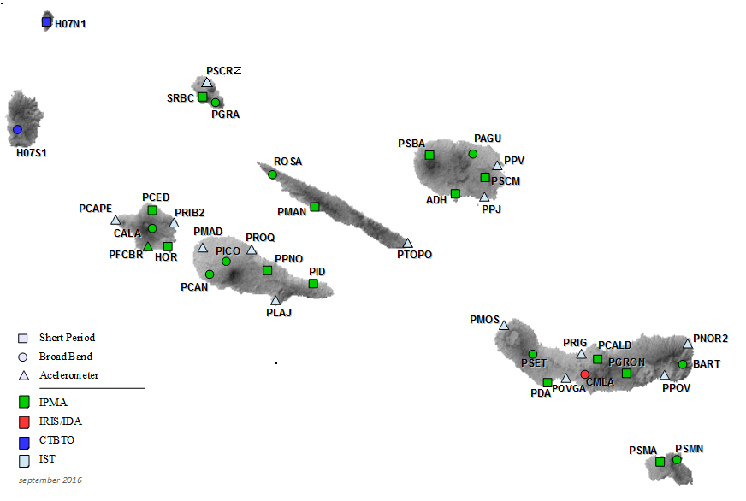
AZORES SEISMIC NETWORK
40 SEISMIC STATIONS

Slide 7
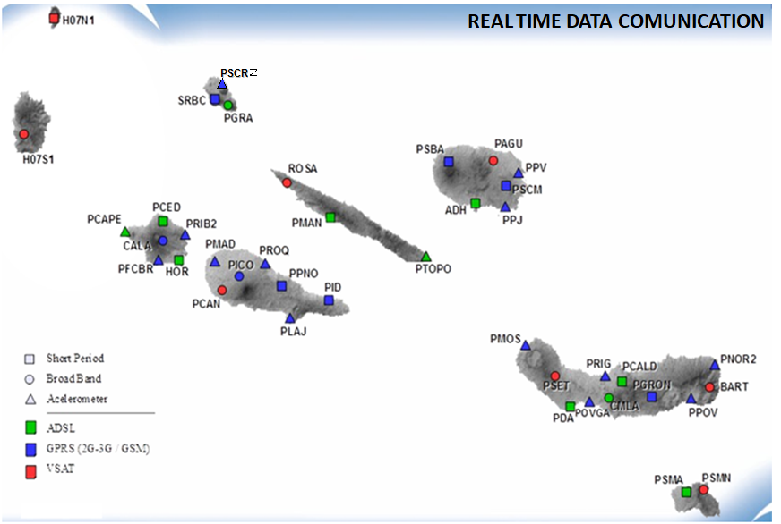
AZORES SEISMIC NETWORK

Slide 8
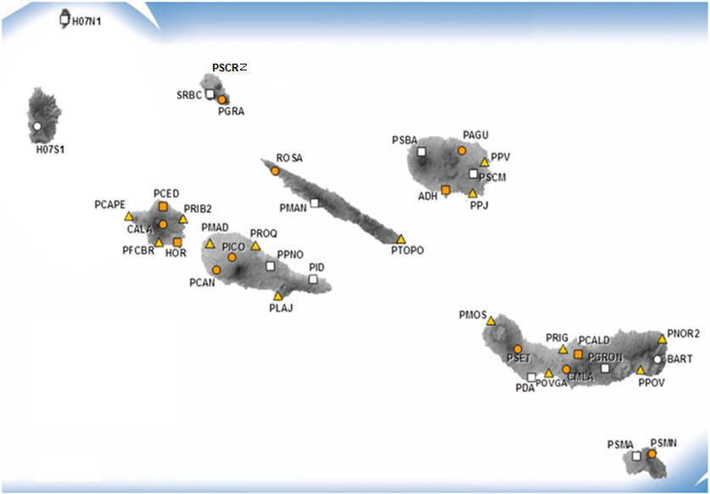
AZORES SEISMIC NETWORK
28 SM SENSORS
(13 redundant)

Slide 9
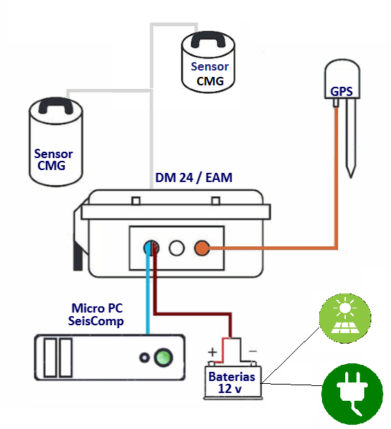
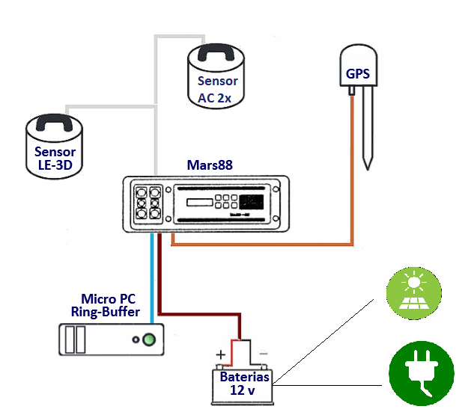
AZORES SEISMIC NETWORK
Digital Seismic Stations Short period (sensors 1s and 5s) Broadband (20s) Strong Motion

Slide 10
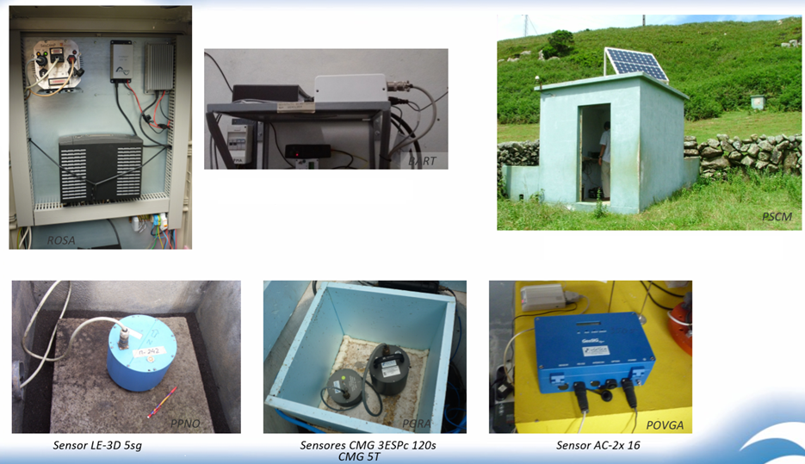
AZORES SEISMIC NETWORK

Slide 11
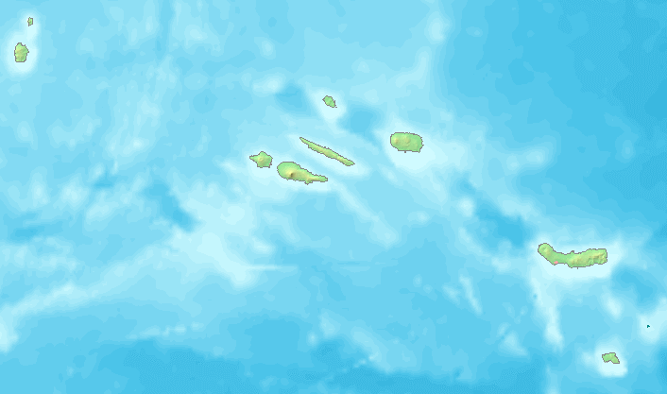
AZORES SEISMIC NETWORK
Network of 3 Observatories
OJA
OPAM
OAC

Slide 12
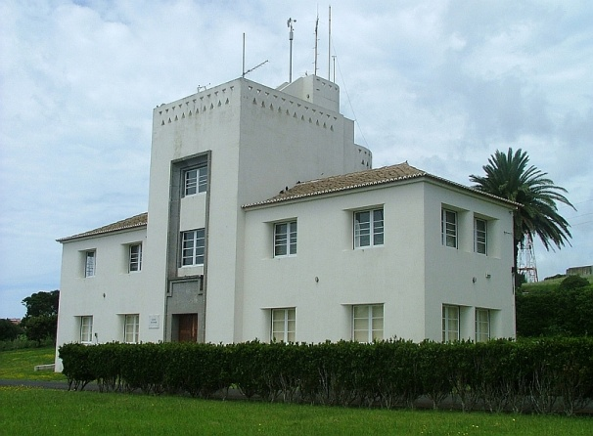
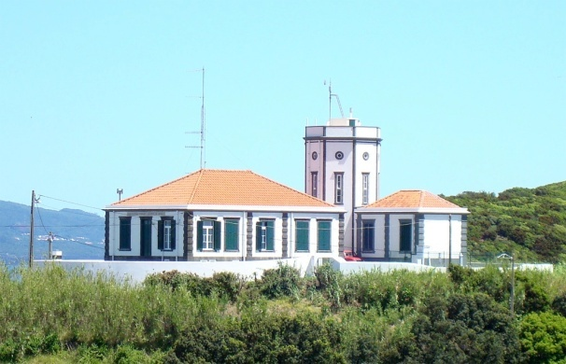
AZORES SEISMIC NETWORK
3 OBSERVATORIES
OJA
OPAM
OAC
Real time monitoring
Data quality control
Automatic signal detection
Automatic association of detections,
event location and magnitude evaluation
Rapid earthquake information
Validation / dissemination
Automatic archive of recorded data

Slide 13
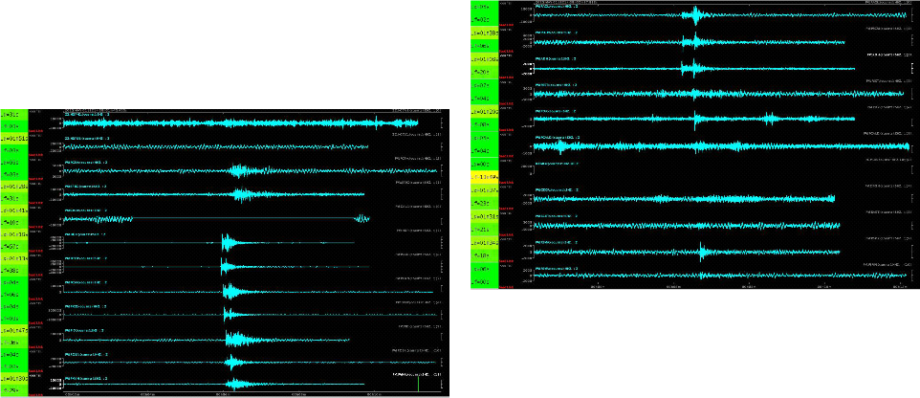
AZORES SEISMIC NETWORK
Real Time (& NRT) monitoring
Azores W
Azores E

Slide 14
AZORES SEISMIC NETWORK
Quality control – latency & State Of Health

Slide 15
AZORES SEISMIC NETWORK
Quality control – Seismic noise

Slide 16
AZORES SEISMIC NETWORK
DETECT AND REPORT Main parameters: Location (latitude, longitude and depth) Magnitude Time at source Type of event (tectonic or volcanic) Potential Intensities Potentially affected sites Depending on the characteristics of the event, launch alerts to the Civil Community, Institutions and Authorities. In practice this detection is performed by complex and almost immediate sequential and automated processes that must be systematically reviewed by an operator before dissemination.

Slide 17
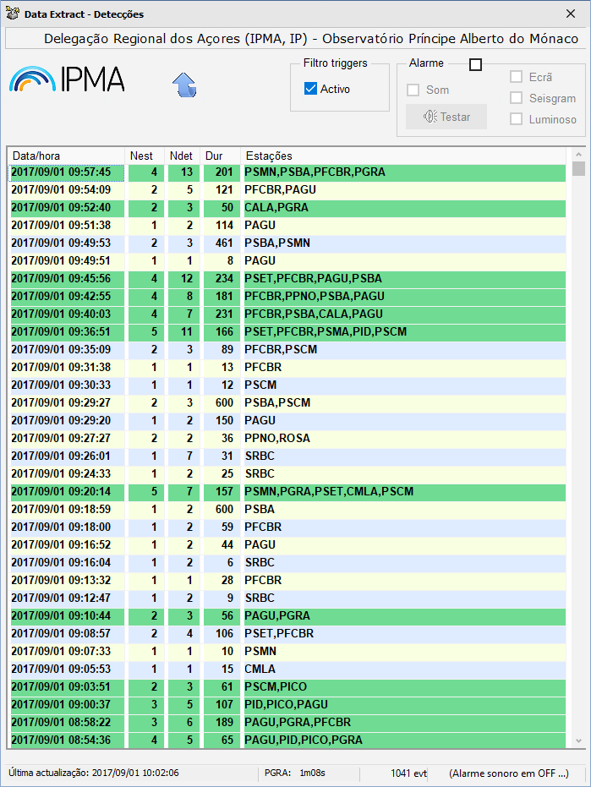
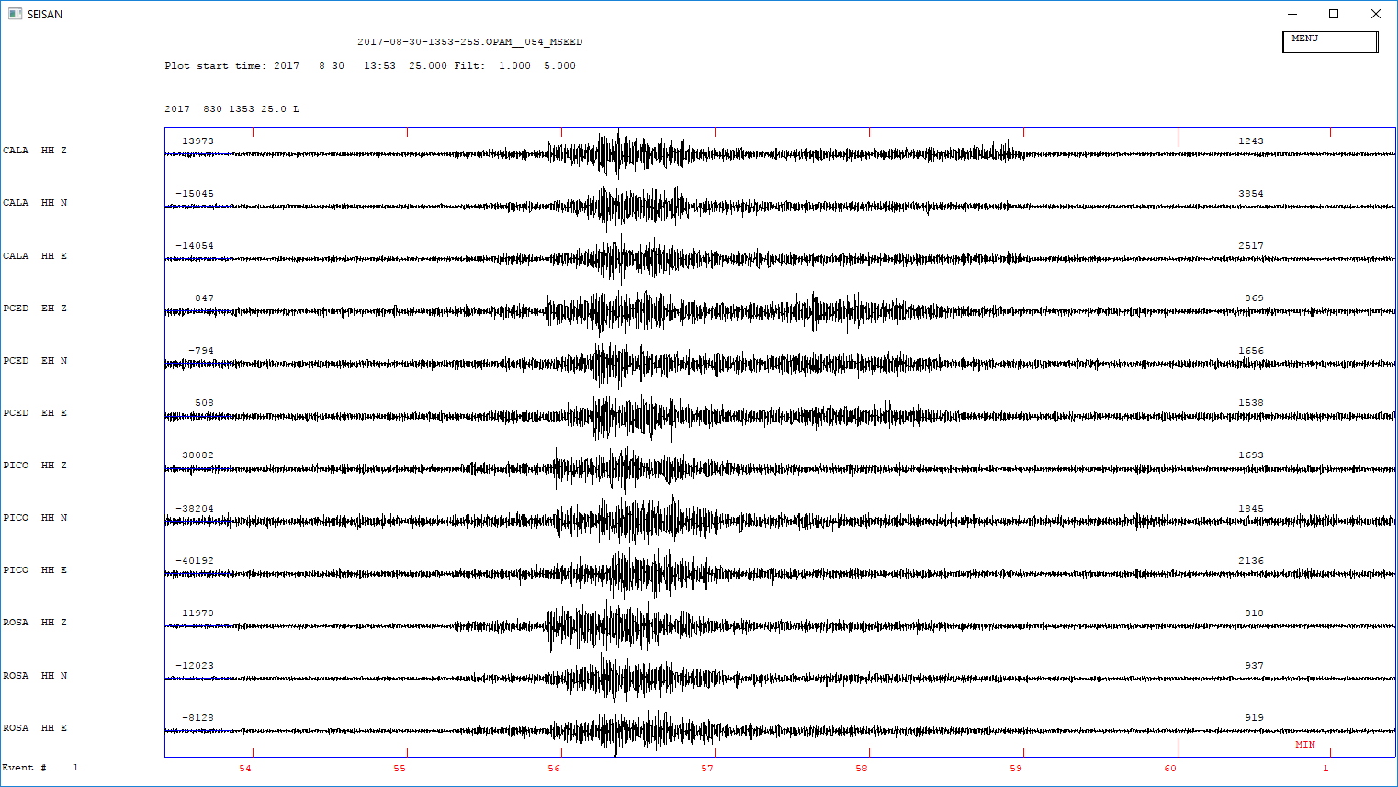
AZORES SEISMIC NETWORK
WorkStation
Data Server
(AutoPick SeiscomP3
STA/LTA trigger)
Data_Extract
Operator validation / launch
of automatic analysis process
SEISAN
Notes:
Picks Association

Slide 18
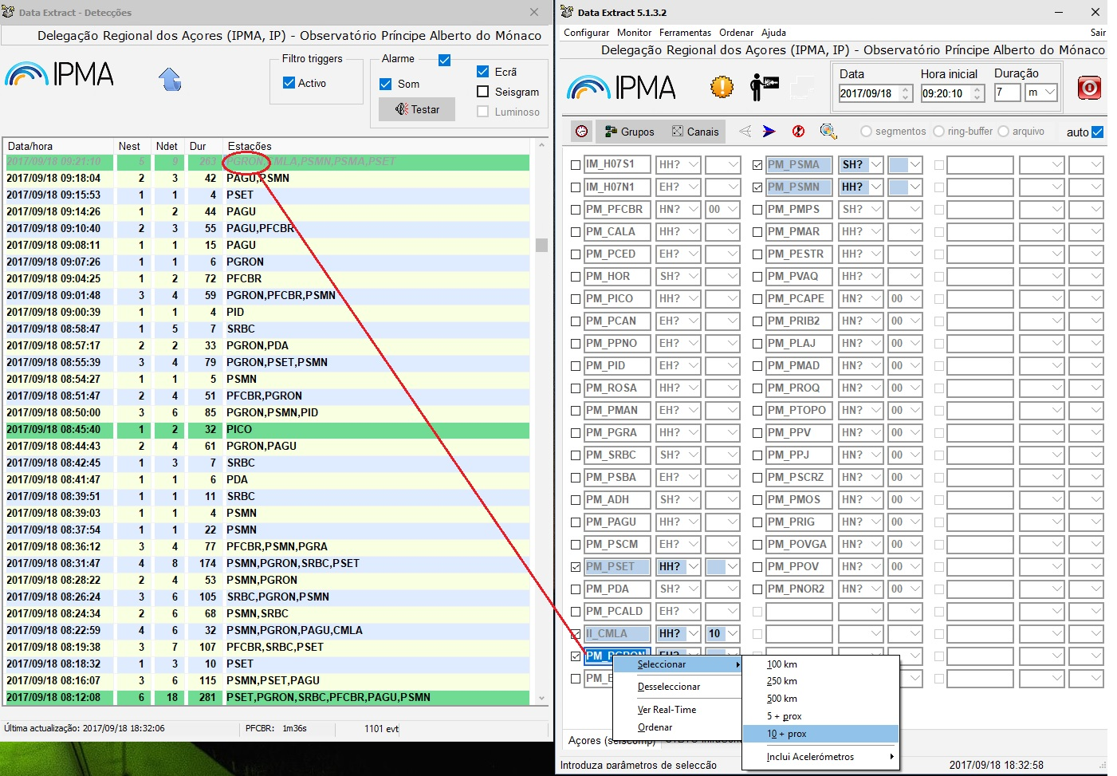
AZORES SEISMIC NETWORK
Data_Extract
Notes:
Picks Association data convertion to mseed format

Slide 19
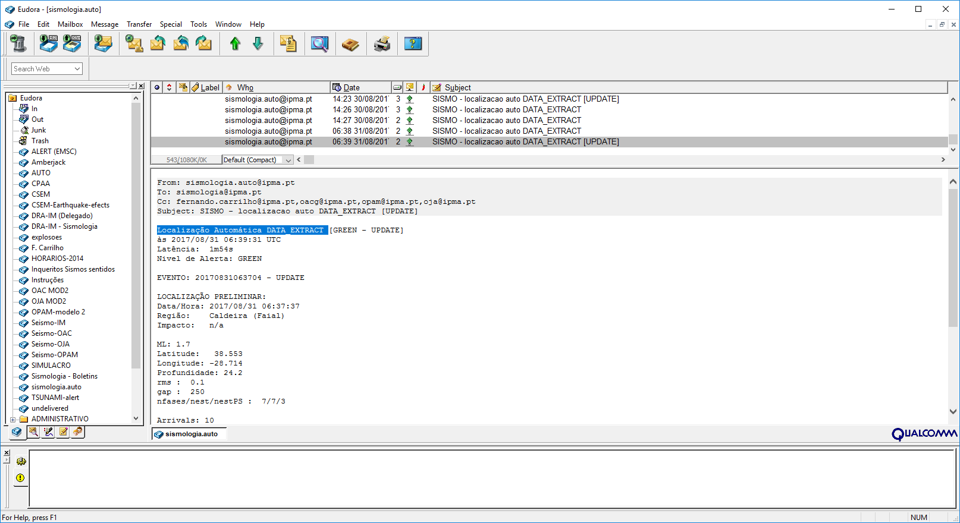
AZORES SEISMIC NETWORK
DB registration of fully automatic SeiscomP3 pickings (email EQ notification)
Operator validation
Notes:
Picks Association

Slide 20
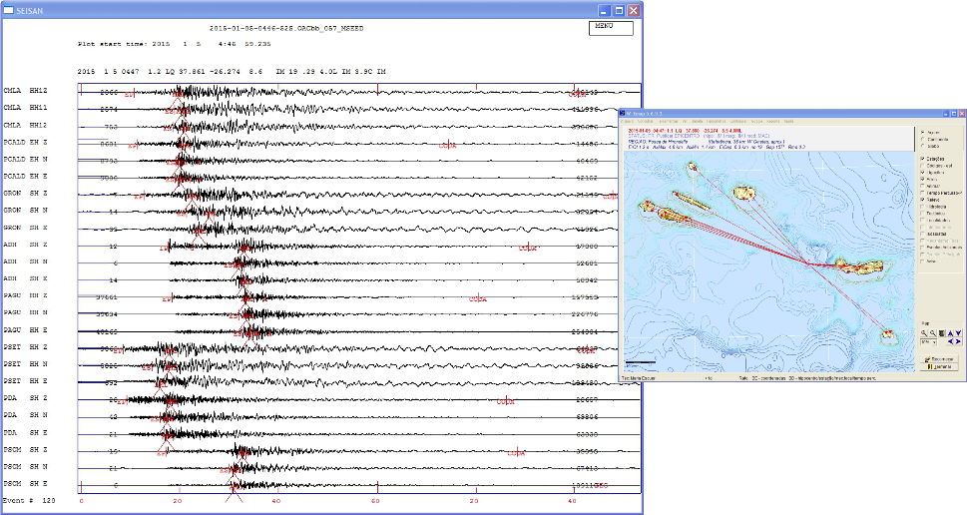
AZORES SEISMIC NETWORK
W_emap
Notes:
Picks Association

Slide 21
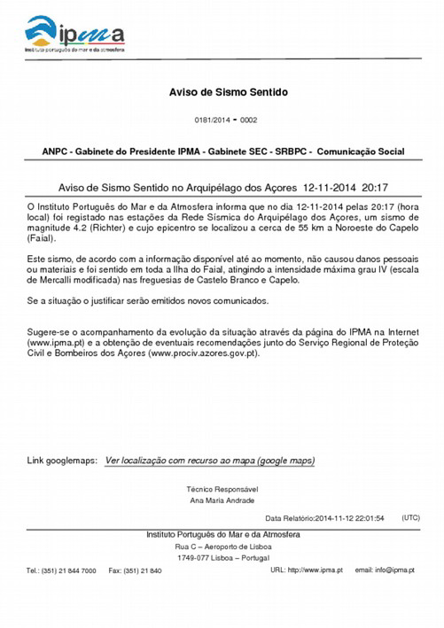
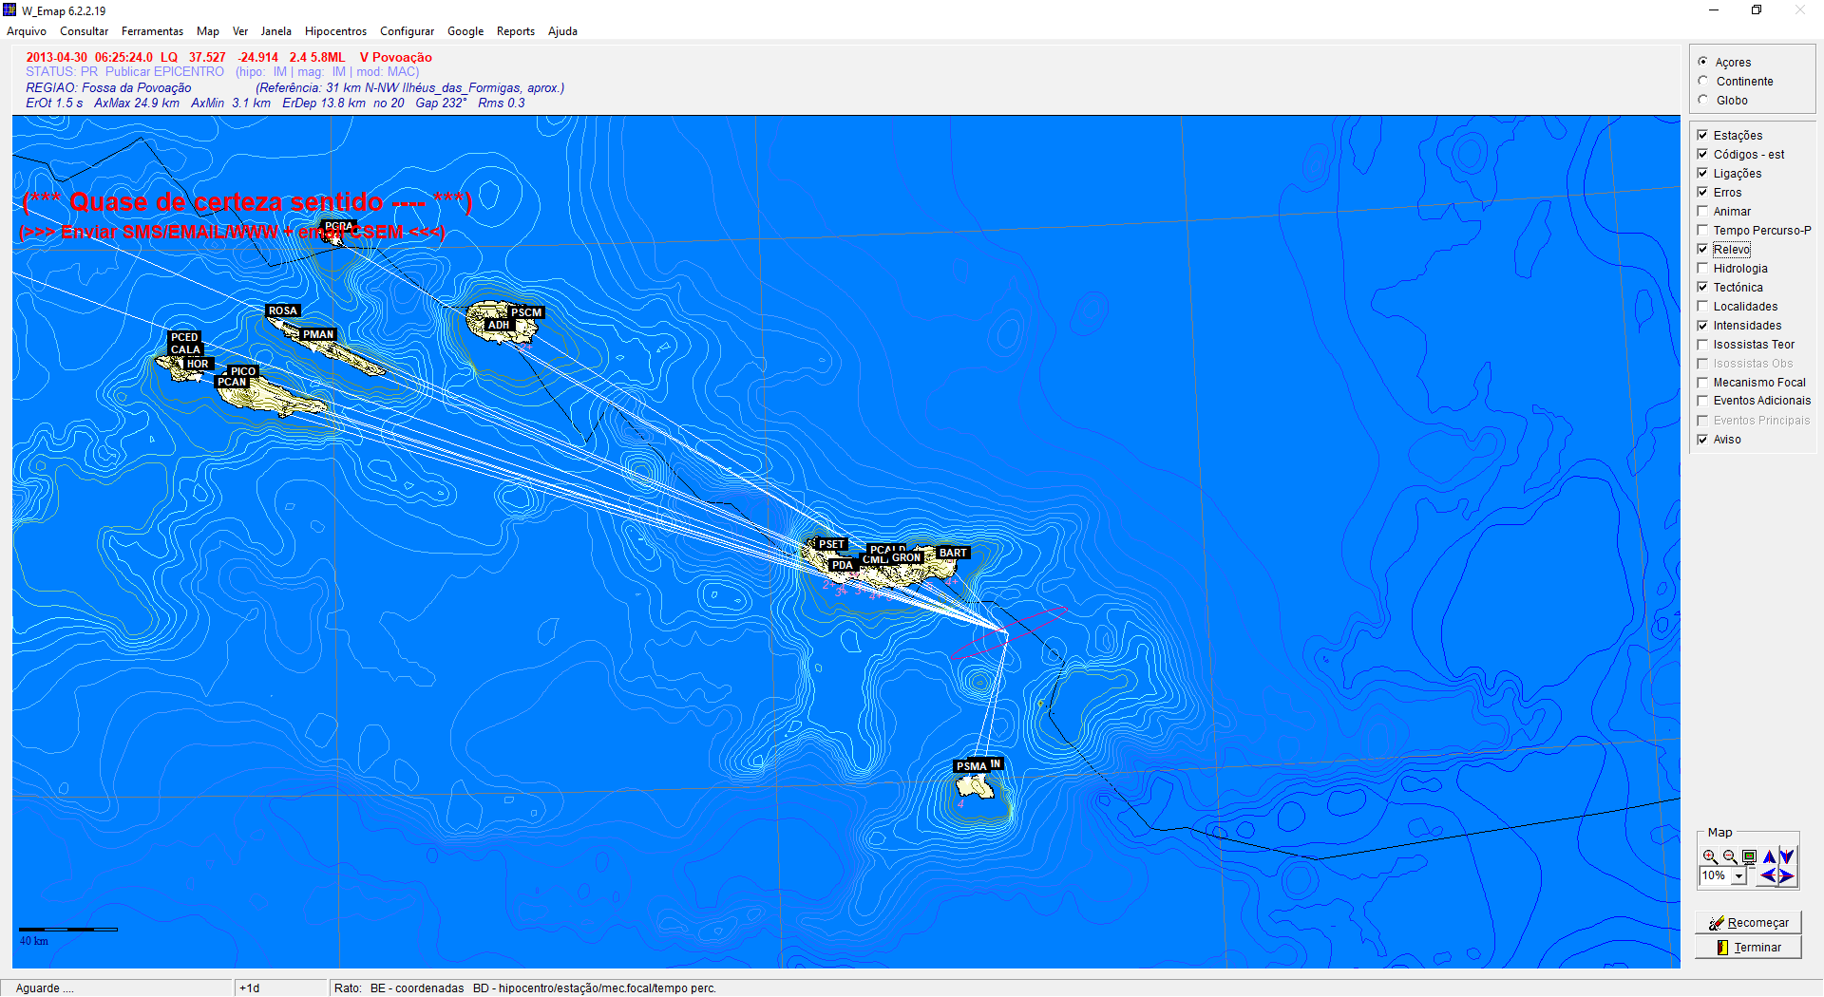
AZORES SEISMIC NETWORK
Warning
Dissemination of seismic data and alert (Email, SMS, Radio, Telephone)
Notes:
O W_EMAP é um software integrador que permite a visualização de epicentros, tectónica, relevo, distribuição de estações sísmicas, toponímia, mecanismos focais, tempos de percurso, distâncias epicentrais, macrossismicidade, serve de interface para Google Map e Google Earth,...
Principalmente, é através desta aplicação que alertas, avisos e comunicados são enviados (ligação ao Eudora) e a macrossismicidade é automaticamente estimada a partir da informação recebida por email (ligação ao Eudora e ao ShakeMap).

Slide 22
AZORES SEISMIC NETWORK
Warning
Dissemination of seismic data and alert (Email, SMS, Radio, Telephone)
Notes:
O W_EMAP é um software integrador que permite a visualização de epicentros, tectónica, relevo, distribuição de estações sísmicas, toponímia, mecanismos focais, tempos de percurso, distâncias epicentrais, macrossismicidade, serve de interface para Google Map e Google Earth,...
Principalmente, é através desta aplicação que alertas, avisos e comunicados são enviados (ligação ao Eudora) e a macrossismicidade é automaticamente estimada a partir da informação recebida por email (ligação ao Eudora e ao ShakeMap).

Slide 23
AZORES SEISMIC NETWORK
Future work:
TSUNAMI Early Warning
Shakemaps Inplementation
Focal Mech. Determination
Azores Seismic Catalogue

